Slide 1

Inheritance Part 1 Java - The Complete Reference Herbert Schildt Chapter 8

Slide 2
Outline
Inheritance Basics
Member Access and Inheritance
A Superclass Variable Can Reference a Subclass Object
Using super
Using super to Call Superclass Constructors
A second use of super
Creating a Multilevel Hierarchy
When Constructors Are Executed
Method Overloading

Slide 3
Inheritance Basics

Slide 4
Inheritance Basics
Inheritance is one of the cornerstones of object-oriented programming because it allows the creation of hierarchical classifications.
Using inheritance, we can create a general class that defines traits common to a set of related items.
This class can then be inherited by other, more specific classes, each adding those things that are unique to it.
A class that is inherited is called a superclass.
The class that does the inheriting is called a subclass.
Therefore, a subclass is a specialized version of a superclass.
It inherits all of the members defined by the superclass and adds its own, unique elements.

Slide 5
Inheritance Basics
Promotes code reuse and logical classification (is-a relationships).
Java uses the extends keyword to create a subclass.
Inheritance forms the basis for polymorphism and method overriding.

Slide 6
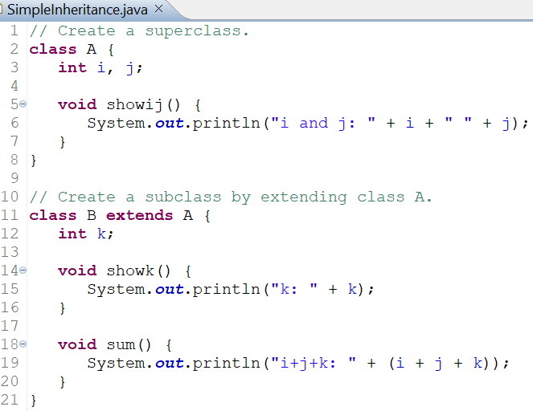
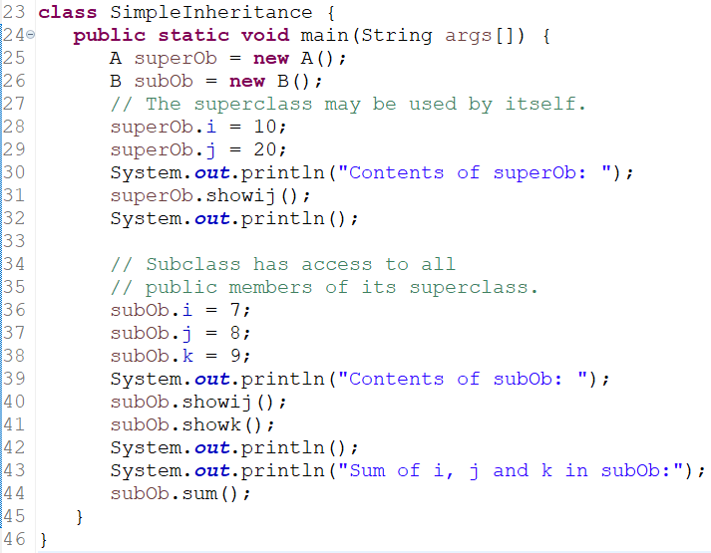
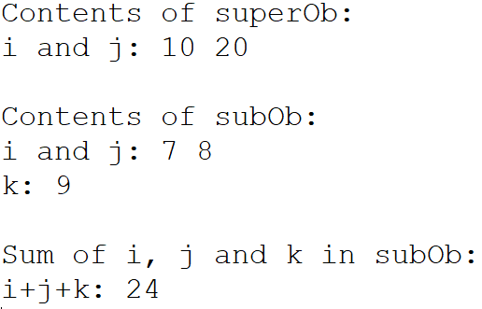
Example: Simple Inheritance
OUTPUT

Slide 7
Inheritance Rules
We can only specify one superclass for any subclass that we create.
Java does not support the inheritance of multiple superclasses into a single subclass.
We can create a hierarchy of inheritance in which a subclass becomes a superclass of another subclass.
No class can be a superclass of itself.

Slide 8
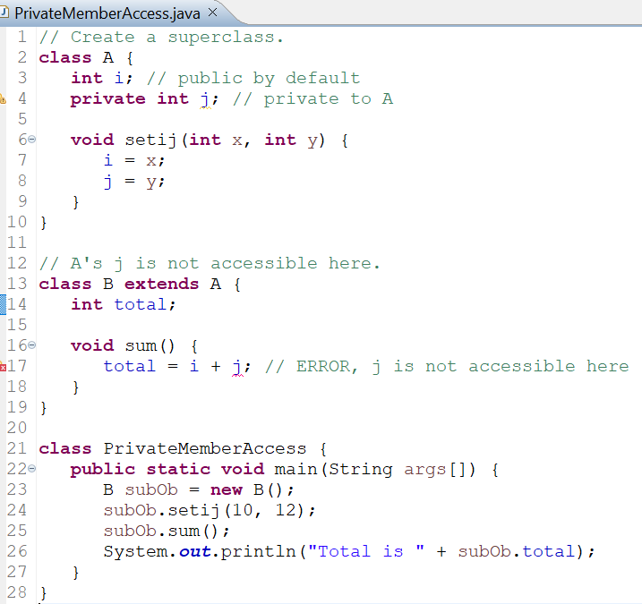
Member Access and Inheritance
Although a subclass includes all of the members of its superclass, it cannot access those members of the superclass that have been declared as private.
A class member that has been declared as private will remain private to its class.
It is not accessible by any code outside its class, including subclasses.

Slide 9
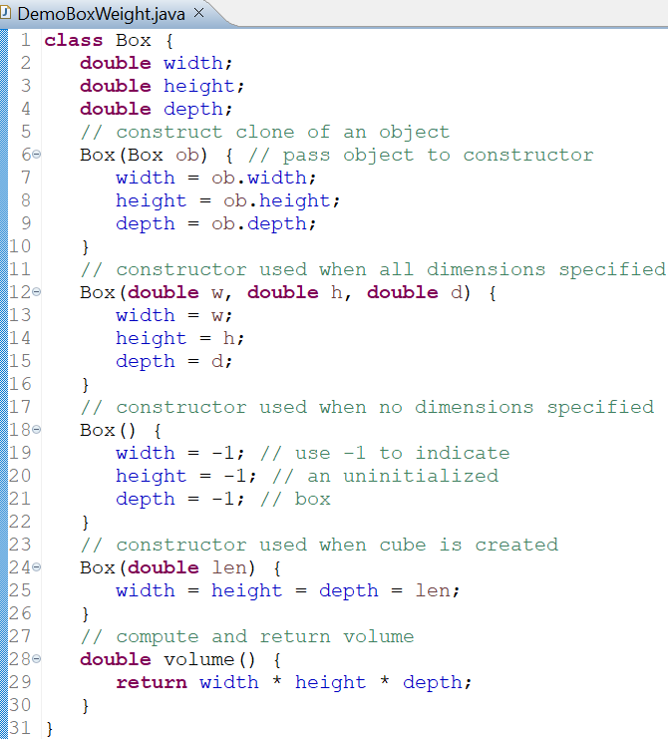
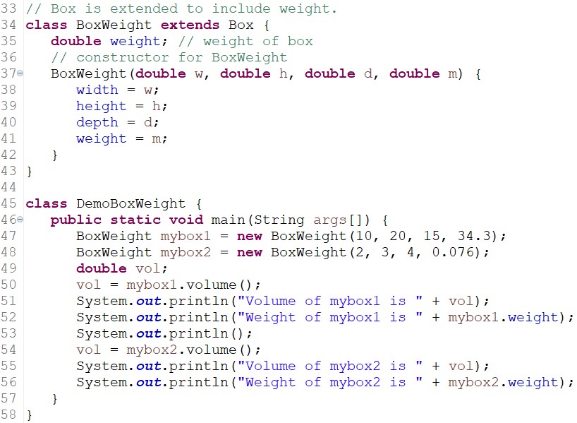
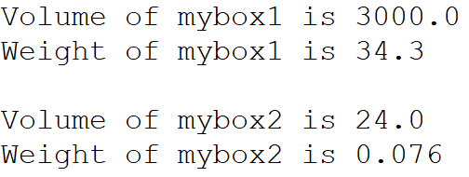
A More Practical Example
OUTPUT

Slide 10
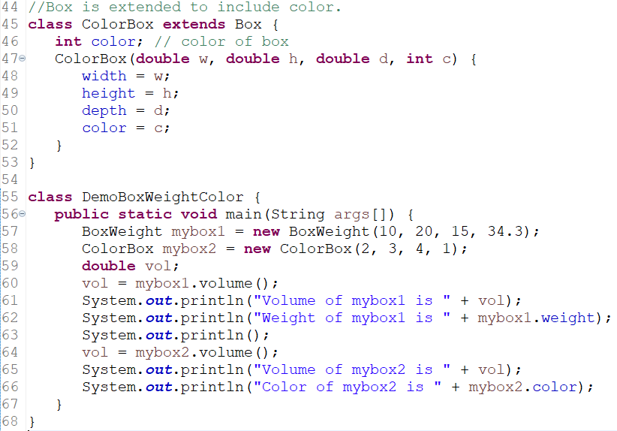
A More Practical Example
A major advantage of inheritance is that once we have created a superclass that defines the attributes common to a set of objects, it can be used to create any number of more specific subclasses.
Each subclass can precisely tailor its own classification.

Slide 11
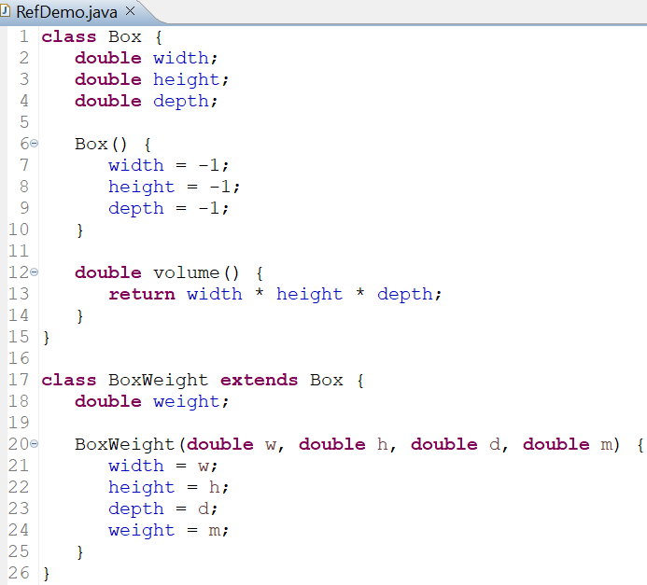
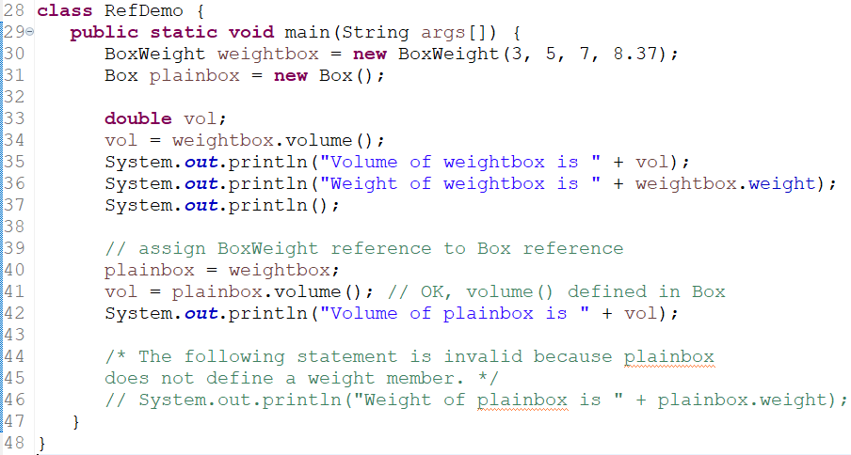
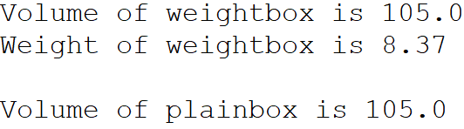
A Superclass Variable Can Reference a Subclass Object
A reference variable of a superclass can be assigned a reference to any subclass derived from that superclass.
OUTPUT

Slide 12
A Superclass Variable Can Reference a Subclass Object
It is important to understand that it is the type of the reference variable — not the type of the object that it refers to — that determines what members can be accessed.
That is, when a reference to a subclass object is assigned to a superclass reference variable, we will have access only to those parts of the object defined by the superclass.
This is why plainbox can't access weight even when it refers to a BoxWeight object.
This makes sense because the superclass has no knowledge of what a subclass adds to it.
This is why the last line of code in the previous slide is commented out.
It is not possible for a Box reference to access the weight field because the Box class does not define the weight field.
This approach has some important practical applications, which are discussed later.

